Slide 1
DEPTH FIRST SEARCH

Slide 2
What is DFS?
The DFS algorithm is a recursive algorithm that uses the idea of backtracking. It involves exhaustive searches of all the nodes by going ahead, if possible, else by backtracking.
Depth-first search (DFS) is an algorithm for traversing or searching tree or graph data structures. The algorithm starts at the root node (selecting some arbitrary node as the root node in the case of a graph) and explores as far as possible along each branch before backtracking.
The DFS uses LIFO STACK.
Time complexity O(V+E), when implemented using an adjacency list.

Slide 3
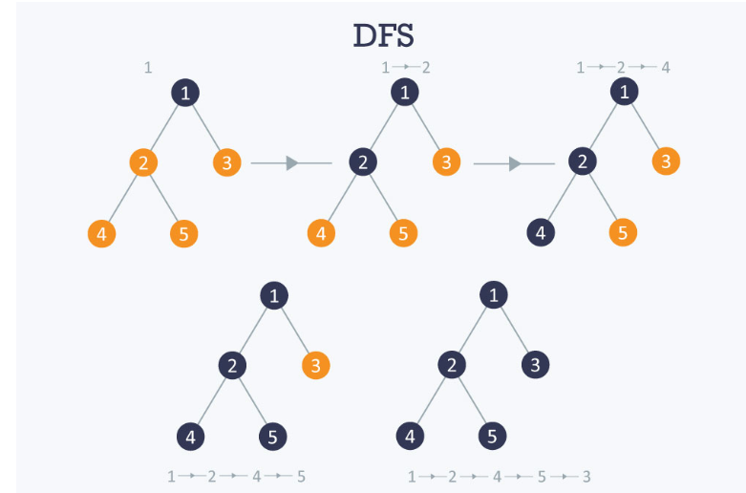

Slide 4
ADVANTAGES-
Find largest distance elements in least time
Less memory is required since its linear with respect to nodes
It is well suited if it has goals in all paths, Eg., If we search for Starbucks from my location, it will definitely find one soon. but if we search for a museum, then it will take more time and might not guarantee to find one
DISADVANTAGES-
Complexity depends on the number of paths
Cannot check duplicate nodes
Get trapped in searching useless paths without a solution
Cannot guarantee to find a solution
Cannot find the minimal solution if two solutions are available

Slide 5
Applications
Finding Connected components
Topological sorting.
Finding Bridges of graph.

Slide 6
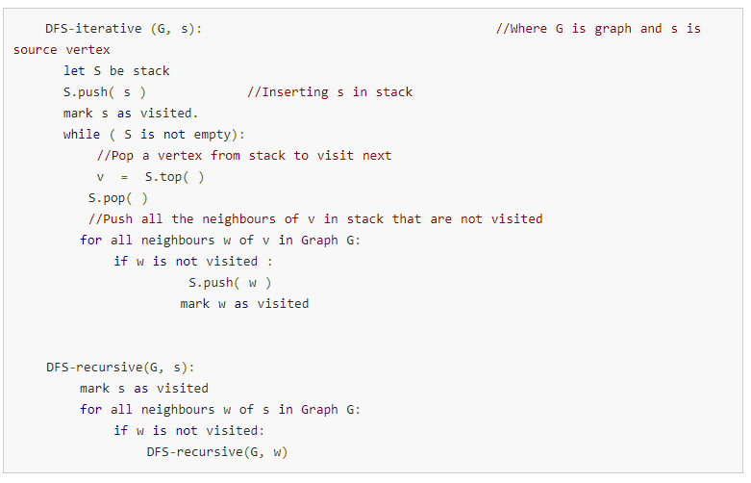

Slide 7
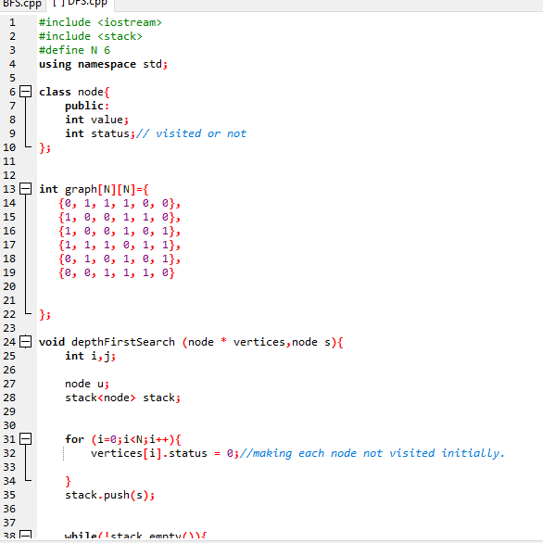
CODE

Slide 8
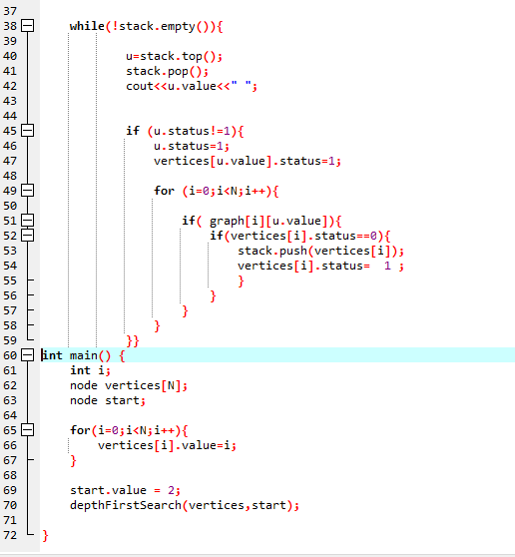

Slide 9
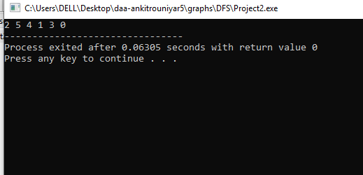
OUTPUT

